Slide 1
4.4: The Law of Sines
MATH 1550 - Precalculus

Slide 2



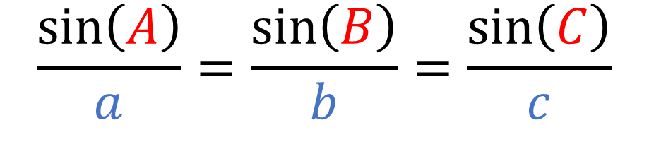



(The Law of Sines) For any triangle:
$$C$$
$$b$$
$$a$$
$$\frac{\sin\left(A\right)}{a}=\frac{\sin\left(B\right)}{b}=\frac{\sin\left(C\right)}{c}$$
$$A$$
$$B$$
$$c$$

Slide 3
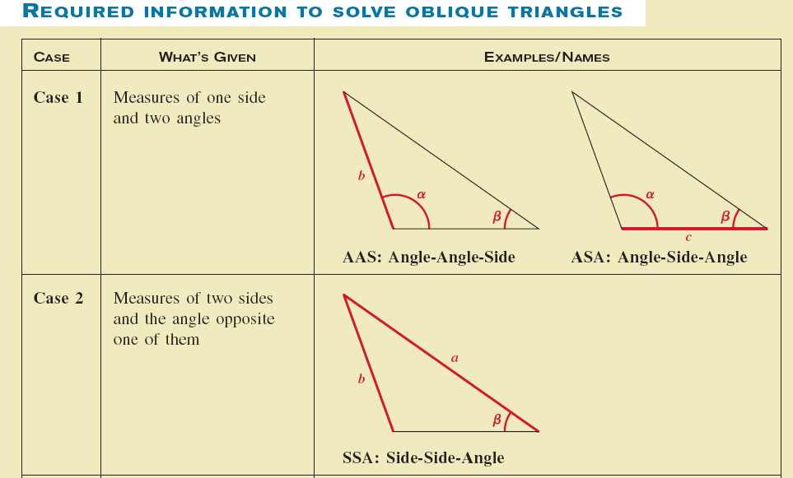
When Can We Use the Law of Sines?
There are three scenarios we can use it: What information do we have?

Slide 4
Ex) Find the missing angles and side lengths of the triangle

Slide 5
Ex) Find the missing angles and side lengths of the triangle

Slide 6
Ex) Find the missing angles and side lengths of the triangle

